Slide 1
Group 3 – Karo Progress
Wendy
Dominik
Job
Janita
Erik

Slide 2
Progress since last week
XNA UI with rotation, selection (beta) and showing AI match (Erik, Wendy)
Last fixes on transposition table (Dominik)
Design UI (Erik, Janita, Job)
Implementing design (Janita, Job)
Menu (Wendy, Erik)

Slide 3
To do for next review
Migrate existing code to the new design
Create methods for move suggestions in the engine
Clicking and selecting

Slide 4
Demo

Slide 5
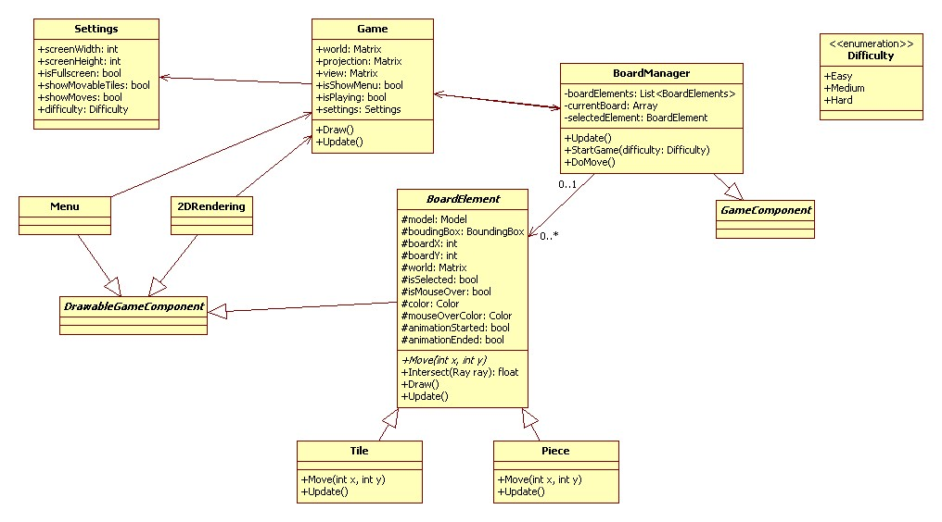
Design

